Slide 1
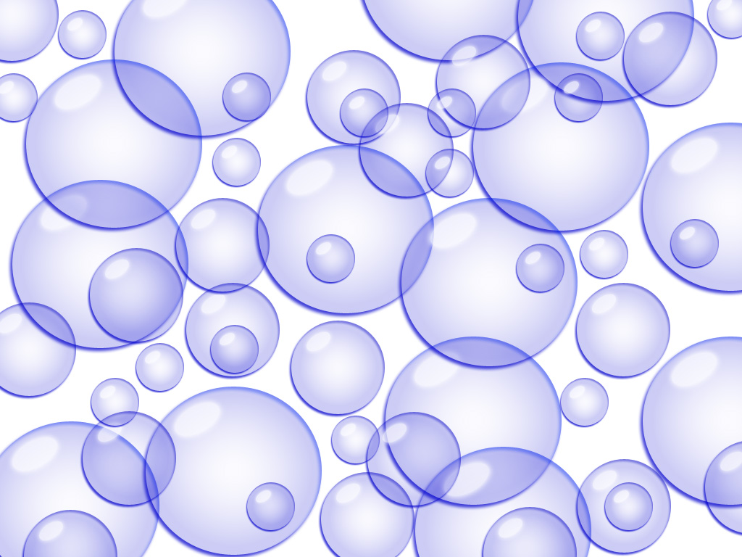
Blowing Bubbles: Long range control of algae using ultrasound Jonathan Newman Waterland Management Ltd

Slide 2
The History of ultrasound
Patented by Langevin in 1916 for submarine detection and protection from fouling
Biological effects observed in 1920s and other effects on cells in 1950s
Used for promoting seed germination 1980s
First unit for control of algae early 1990s
Several versions, copies, developments and little focussed R&D

Slide 3
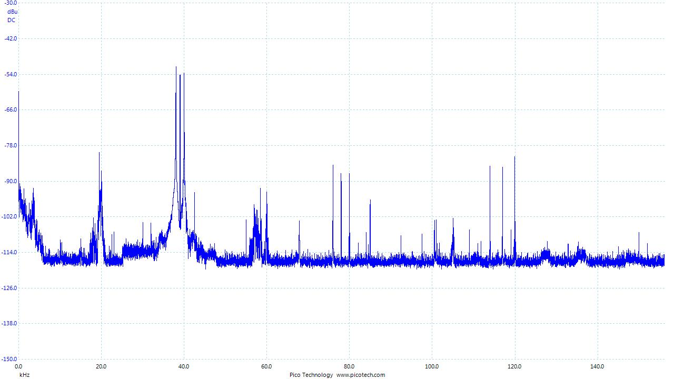
Research & Development
Frequency selection
The magic frequency
Species response
Why are some types resistant
Power selection
Frequency – Application pairing
Prime numbers
Remote operation
Communications, monitoring
Solar power options
24 V UL approval

Slide 4
How does it work?
Shear stress from continuous ultrasound
Mechanical damage to cells at very close range
Pulsed Ultrasound
Cell Boundary layers supersaturated with dissolved gases
Bubbles created by ultrasonically induced pressure differences and nucleation sites on algal cell surfaces
Bubbles collapse after about half a second
Localised Cellular Micro-Cavitation
Very high pressure and temperature
Oxidising compounds created

Slide 5
Ultrasound effects on water
H₂O ⇌ OH• + H• (Hydroxyl radical and - pH
OH• + OH• → H₂O₂ (membrane oxidation)
OH• + OH• ⇌ H₂O + O• (singlet Oxygen radical)
OH• + OH• → H₂ + O₂
H• + O₂ → HO₂•
HO₂• + H• → H₂O₂ (membrane oxidation)
HO₂• + HO₂• → H₂O₂ + O₂ (membrane oxidation)
OH• + H₂O ⇌ H₂O₂ + O• (membrane oxidation)
H₂O + O• → H₂O₂ (membrane oxidation)
H• + H• → H₂

Slide 6
How it CANNOT work (at distance)
Blue green algal cell vesicle collapse
May be caused as a response to increased O₂ concentration
Photosynthetically mediated response to light (= O₂ concentration)
Harmonic resonance destruction of vacuoles
Cells not that flexible
No microscope evidence for vacuole collapse
Sonophoresis / electroporation
What toxin?
Osmotic regulation, requires membrane damage

Slide 7
Sound Pressure and Potential Range
600 m

Slide 8
Localised Cellular Cavitation in Boundary Layer
400 – 700% air saturation of dissolved gases in boundary layer from photosynthesis and respiration
Ultrasound Waves create pressure stress
CO₂
O₂
Algal Cell
CO₂
Gas-enriched boundary layers have lower resistance to bubble formation than open water and more nucleation points
O₂
Waves parallel to surface create shear stress

Slide 9
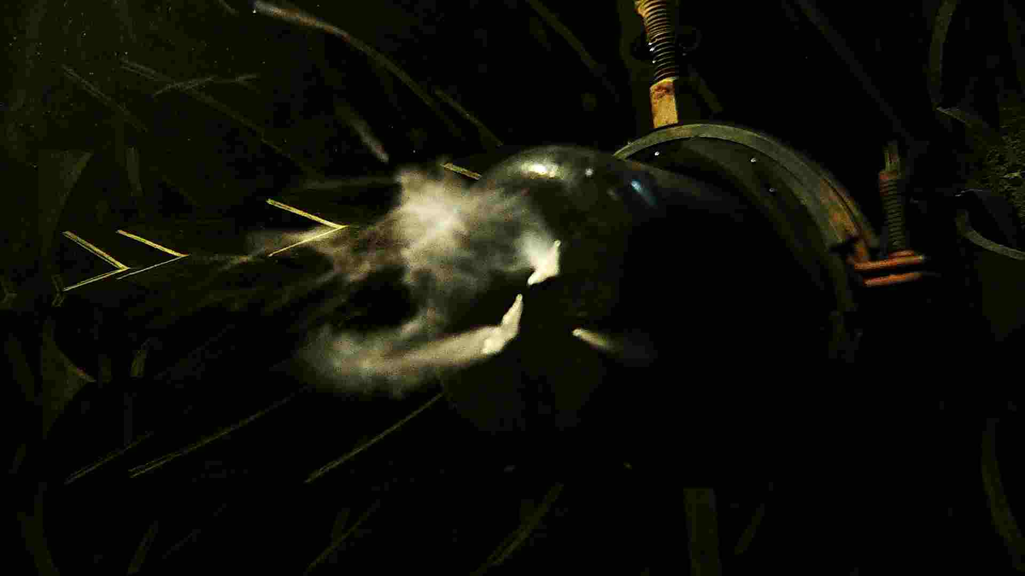
Ultrasound creates sonoluminescence by dissociating water molecules

Slide 10
Stress Response of Algal Families to Ultrasound - cytochrome c

Slide 11
Species tested to date
Purcell, D. (2009) Control of algae in reservoirs with ultrasound. PhD Thesis Cranfield university

Slide 12
Case Study - Germany
October 2011
October 2012

Slide 13
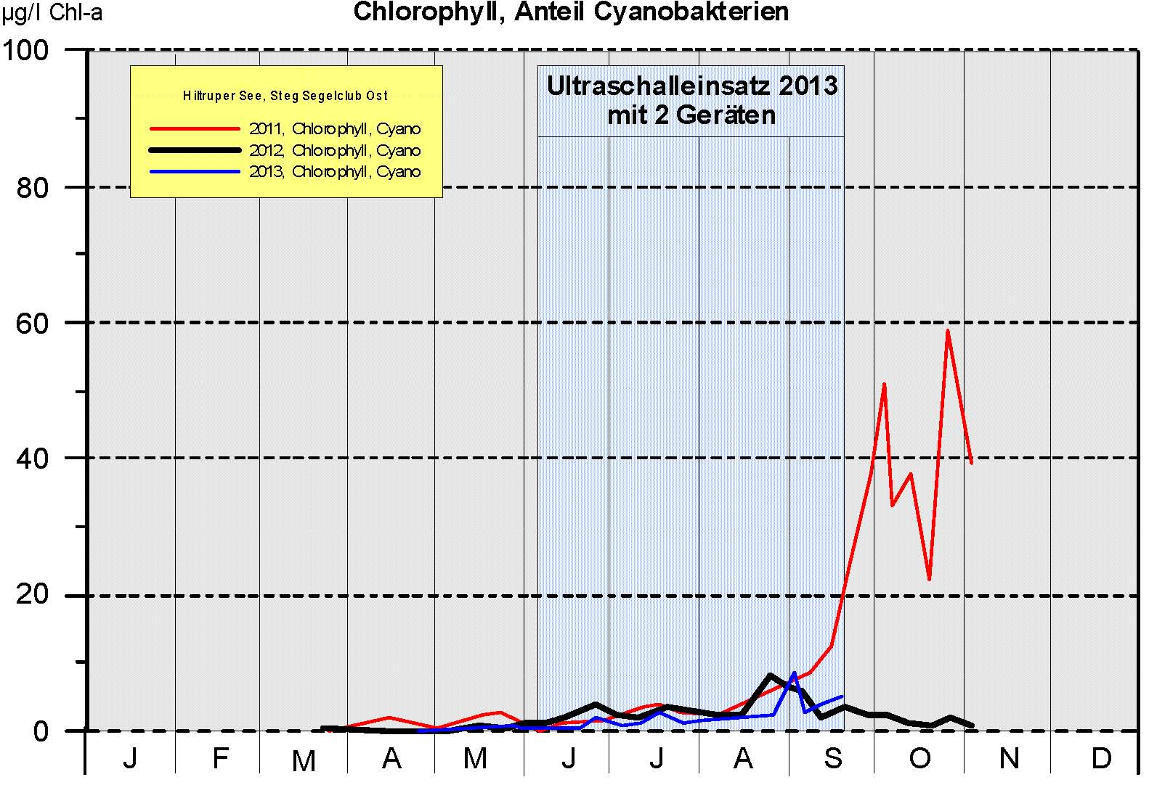
Munster, Germany: Cyanobacteria

Slide 14
Case Study – Loweswater UK

Slide 15
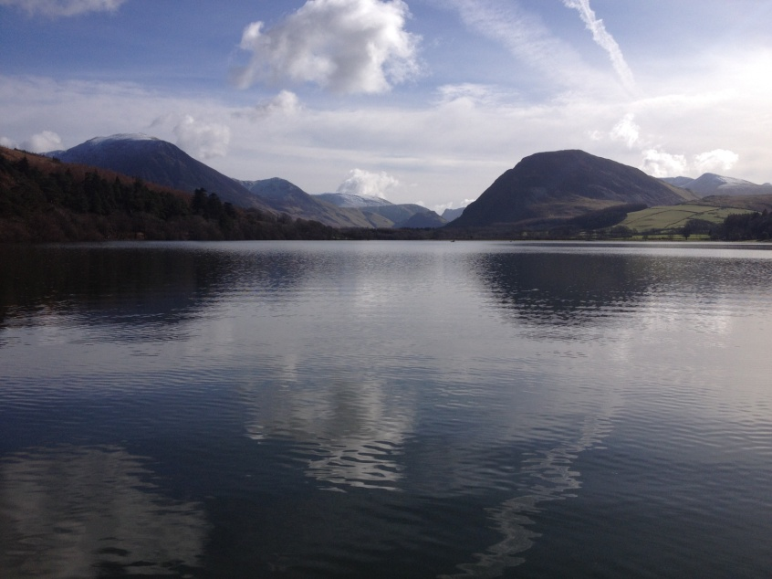
Loweswater
Solar Powered system
Monitoring by Xylem Sonde
Ultrasound detection using hydrophone
Problem Blue Green Algae:
Planktothrix
Woronichia
Snowella

Slide 16
Loweswater raft

Slide 17
Sonde data
4 Units
4 + 1 PVS Unit

Slide 18
Loweswater Chlorophyll

Slide 19
Loweswater
965 m

Slide 20
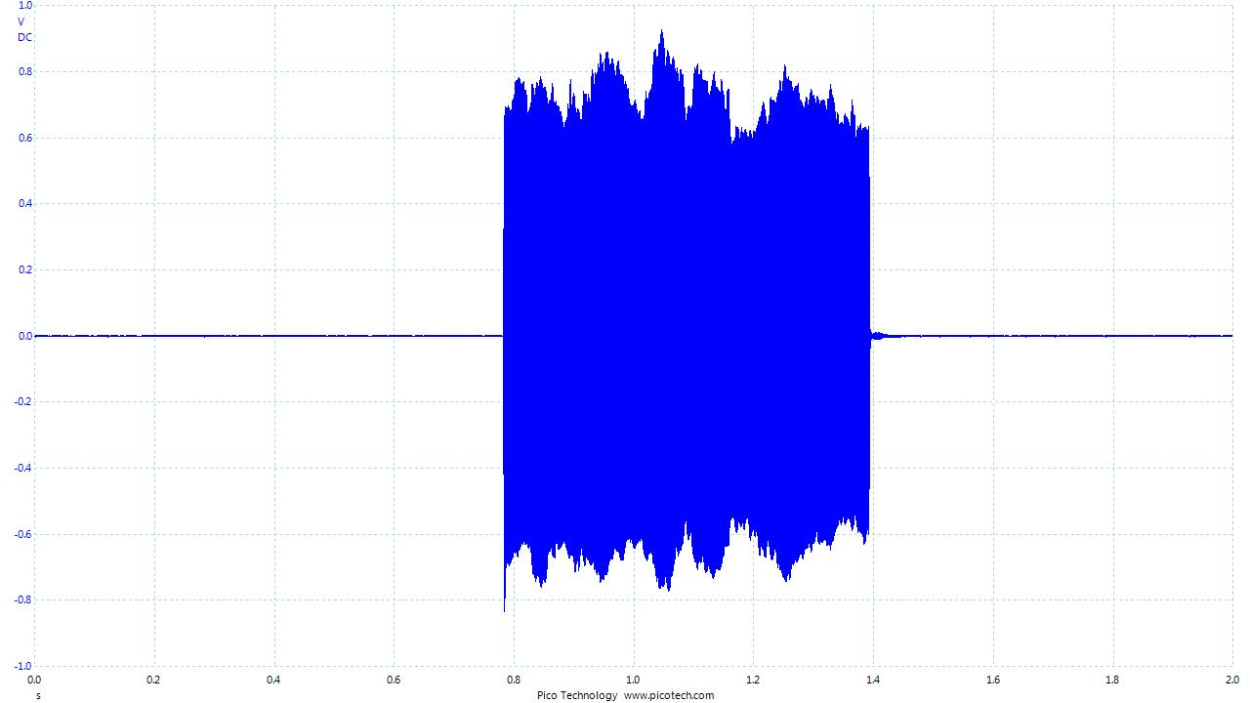
10 m away

Slide 21
Loweswater
965 m

Slide 22
965 m away

